Slide 1
Backpropagation
Hung-yi Lee

Slide 2
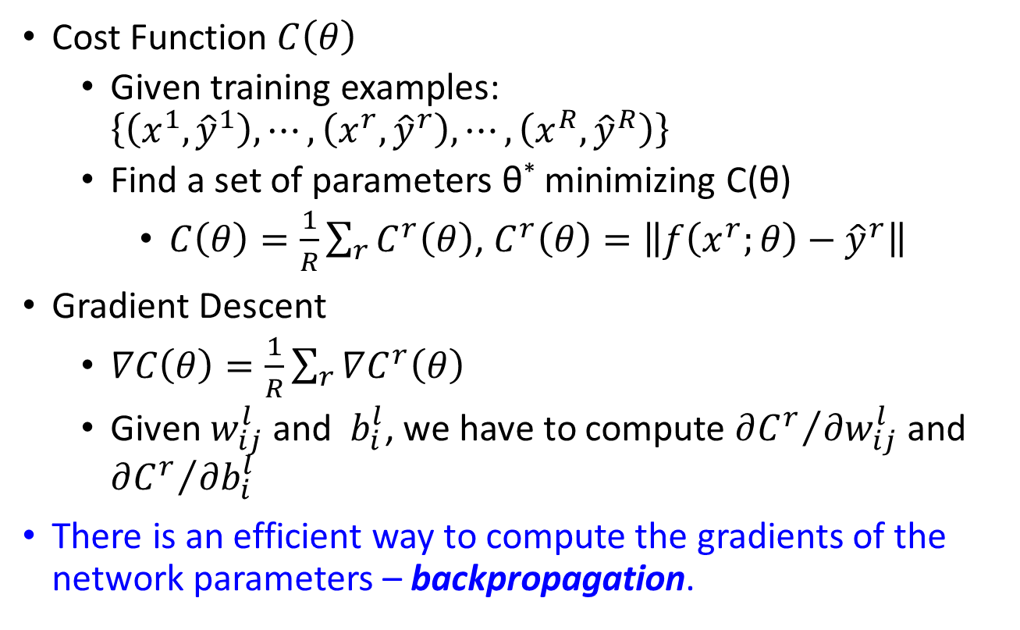
Background
Cost Function $C\left(θ\right)$
Given training examples: $\left\{\left(x^{1},{\hat{y}}^{1}\right),⋯,\left(x^{r},{\hat{y}}^{r}\right),⋯,\left(x^{R},{\hat{y}}^{R}\right)\right\}$
Find a set of parameters θ* minimizing C(θ)
$C\left(θ\right)=\frac{1}{R}\sum_{r}{C^{r}\left(θ\right)}$, $C^{r}\left(θ\right)=\left\|f\left(x^{r};θ\right)−{\hat{y}}^{r}\right\|$
Gradient Descent
$∇C\left(θ\right)=\frac{1}{R}\sum_{r}{∇C^{r}\left(θ\right)}$
Given $w_{ij}^{l}$ and $b_{i}^{l}$, we have to compute ${∂C^{r}}/{∂w_{ij}^{l}}$ and ${∂C^{r}}/{∂b_{i}^{l}}$
There is an efficient way to compute the gradients of the network parameters – backpropagation.

Slide 3
Chain Rule
Case 1
Case 2

Slide 4
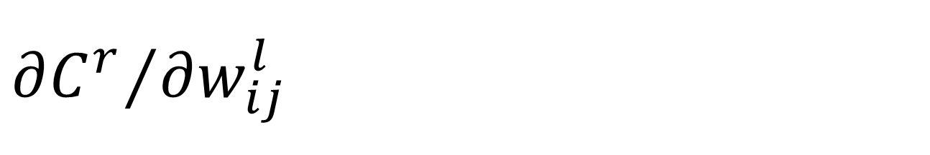
$${∂C^{r}}/{∂w_{ij}^{l}}$$
Layer
Layer
…
…
…
…
is the multiplication of two terms

Slide 5
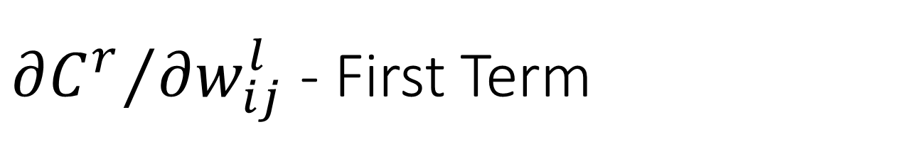
${∂C^{r}}/{∂w_{ij}^{l}}$ - First Term
Layer
Layer
…
…
…
…
is the multiplication of two terms

Slide 6
${∂C^{r}}/{∂w_{ij}^{l}}$ - First Term
Layer l-1
Layer l
If l > 1
…
…
…
…

Slide 7
${∂C^{r}}/{∂w_{ij}^{l}}$ - First Term
Input
Layer 1
If l > 1
…
…
If l = 1
…
…

Slide 8
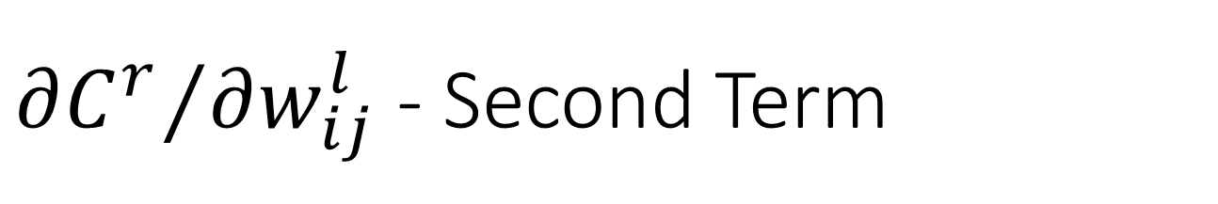
${∂C^{r}}/{∂w_{ij}^{l}}$ - Second Term
Layer
Layer
…
…
…
…
is the multiplication of two terms

Slide 9
${∂C^{r}}/{∂w_{ij}^{l}}$ - Second Term
1. How to compute
2. The relation of and
Layer L
(output layer)
Layer l-1
Layer l
Layer l+1
……
……
…
…
…
…
……
…
…
…
…

Slide 10
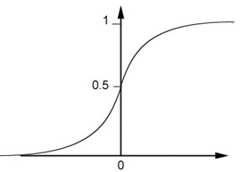
${∂C^{r}}/{∂w_{ij}^{l}}$ - Second Term
1. How to compute
2. The relation of and
Layer L
(output layer)
Depending on the definition of cost function
…
…

Slide 11
${∂C^{r}}/{∂w_{ij}^{l}}$ - Second Term
1. How to compute
2. The relation of and
element-wise multiplication

Slide 12
${∂C^{r}}/{∂w_{ij}^{l}}$ - Second Term
1. How to compute
2. The relation of and
Layer l
Layer l+1
…
…
…
…
…
…

Slide 13
${∂C^{r}}/{∂w_{ij}^{l}}$ - Second Term
…
Layer l
Layer l+1
…
…
…
…
…
Notes:
Should be clearer

Slide 14
${∂C^{r}}/{∂w_{ij}^{l}}$ - Second Term
Layer l
Layer l+1
new type of neuron
output
input
…
…
…
…
…
multiply a constant
…

Slide 15
${∂C^{r}}/{∂w_{ij}^{l}}$ - Second Term
Layer l
Layer l+1
…
…

Slide 16
${∂C^{r}}/{∂w_{ij}^{l}}$ - Second Term
Layer l
Layer l+1
Compare
Layer l
Layer l+1
…
…
…
…
…
…

Slide 17
1. How to compute
2. The relation of and
Layer l
Layer l+1
Layer L-1
Layer L
……
……
…
…
…
…
……
…
…
…
…

Slide 18
Concluding Remarks
Layer
Layer
Forward Pass
Backward Pass
…
…
…
…
Notes:
https://theclevermachine.wordpress.com/

Slide 19
Acknowledgement
感謝 Ryan Sun 來信指出投影片上的錯誤

